Slide 1
Final Project
William Watkins
CS 375
12/19/2019

Slide 2
Part I:
Perfect Numbers

Slide 3
Definition
“Perfect number, a positive integer that is equal to the sum of its proper divisors”
-Encyclopedia Britannica

Slide 4
Aliquot Sum
“In number theory, the aliquot sum s(n) of a positive integer n is the sum of all proper divisors of n, that is, all divisors of n other than n itself.”
“A number whose aliquot sum equals its value is a PERFECT number (6 for example).”
-Geeks for Geeks

Slide 5
Euclid
“Euclid, over two thousand years ago, showed that all even perfect numbers can be represented by,
N = 2^{p-1}(2^{p} -1) where p is a prime for which 2^{p} – 1 is a Mersenne prime.”
-BYJU’s

Slide 6
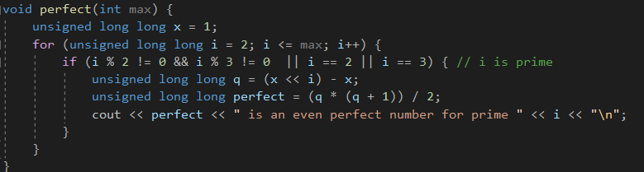
Algorithm
Will this find perfect numbers up to the given max?

Slide 7
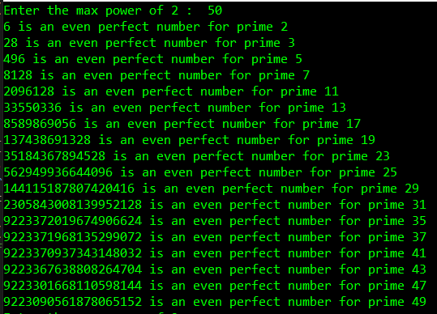
Algorithm
Notice 25, 35, and 49
are not prime numbers,
and the perfect numbers
after prime 31 seem off.

Slide 8
Algorithm
So if we add 5 and 7 to the list of divisors, this will correct the code, right?
Also, unsigned long long will only handle numbers up to
approximately 19 digits, so we will set 2³¹ as our max possible.

Slide 9
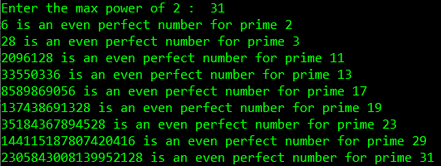
Algorithm
Now the primes are correct,
but some of the numbers are
not on the list of official
perfect numbers. Has the
algorithm discovered new
perfect numbers?

Slide 10
2096128
Divisors I found:
1048064, 524032, 262016, 131008, 65504, 32752, 16376, 8188, 4094, 2047, 1024, 512, 256, 128, 64, 32, 16, 8, 4, 2, 1…
And their sum is 2096128

Slide 11
But…
-Notes from Euclid’s Elements
Book IX
23 and 89 are factors of 2047, therefore they are factors of 2096128 also, so 2096128 is not a perfect number, and 2047 is not a Mersenne prime.

Slide 12
Algorithm
This part of code would have to be updated as i gets larger, so this is insufficient. We need to find if i is prime, and we also need to find if 2^{i} is prime, making 2^{i} a Mersenne prime number.

Slide 13
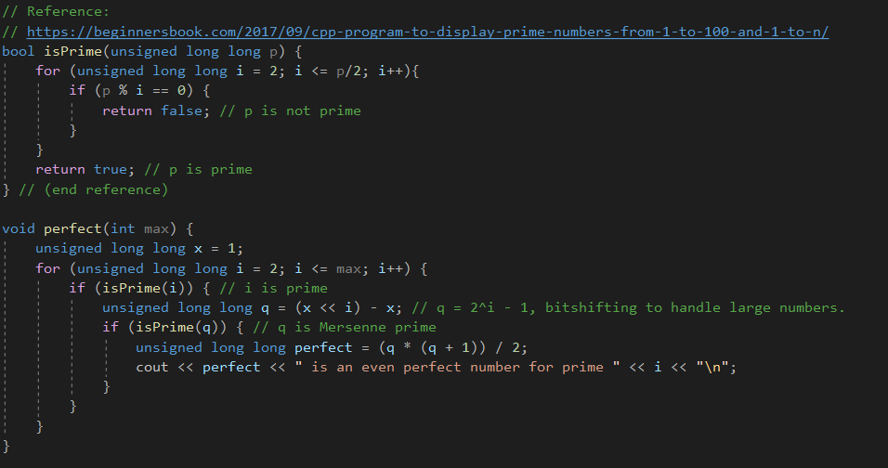

Slide 14
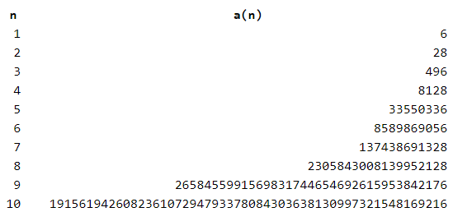
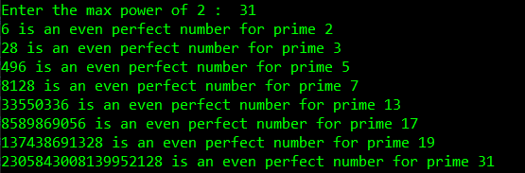
Algorithm
Now our list of perfect
numbers matches those
on the list of official
perfect numbers.
-OEIS, The On-Line Encyclopedia
of Integer Sequences

Slide 15
Part II:
Kaprekar Numbers

Slide 16
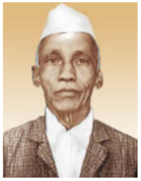
Shri Dattathreya Ramachandra Kaprekar
“was an Indian mathematician, whose name is associated with a number of concepts in number theory. He was born in Dahanu, near Mumbai, in India.” (1905-1986)
-onlinejudge.org

Slide 17
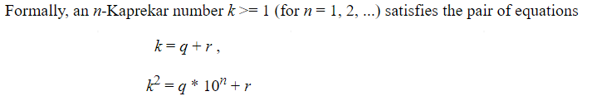
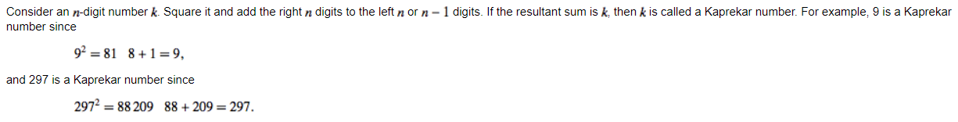
Definition
-Journal of Integer Sequences, Vol. 3 (2000), Article 00.1.2
-Wolfram Alpha

Slide 18
Properties / Patterns
The number 9 has a similar property. The sum of the resulting digits from the product of 9 and another single digit integer total 9. Examples:
9 * 3 = 27 → 2 + 7 = 9
9 * 6 = 54 → 5 + 4 = 9
9 * 8 = 72 → 7 + 2 = 9
9² = 81 → 8 + 1 = 9

Slide 19
Properties / Patterns
9² = 81 → 8 + 1 = 9
This makes 9 a Kaprekar number. Because of this property, I have looked for similarities in Kaprekar numbers and found when divided by 9, the remainder is either 0 or 1, meaning they either divide evenly, or have a repeating decimal at the end of .1111111…
1 = 9/9
9 = 9 * 1
45 = 9 * 5
55 = 9 * 6.111111
99 = 9 * 11
297 = 9 * 33
703 = 9 * 78.111111
999 = 9 * 111
2223 = 9 * 247
2728 = 9 * 303.111111
4879 = 9 * 542.111111
4940 = 9 * 550

Slide 20
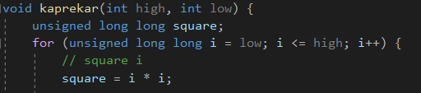
Algorithm
We begin with a for loop and square our iterator. We will be checking if the digits of the square can be split into two numbers whose sum equals i.

Slide 21
Algorithm
As the program checks if a number is a Kaprekar number or not, this will be the first property to check, because it only requires two operations:
Then we will count the number of digits, divide by two, and separate the digits to where the left number will consist of n/2 or n/2 – 1 digits, and the right number will consist of n/2 digits. This is where there is some variation in Kaprekar numbers. One list consists of those that fall under this category, where the other does not. Example:
5292² = 28005264 → 28 + 5264 = 5292
This number is listed on OEIS list A006886 but not A053816
-oeis.org

Slide 22
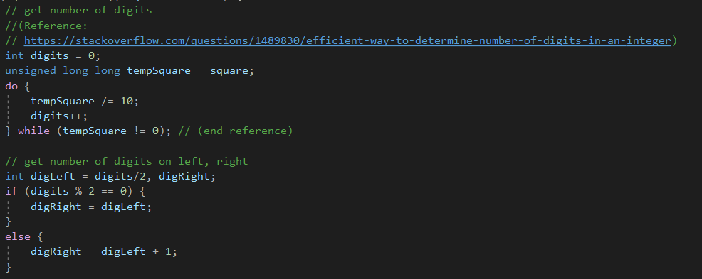
Algorithm
Here we count digits by counting how many times the unsigned long long integer may be divided by 10. Then we find the number of digits for the left number and the right number.

Slide 23
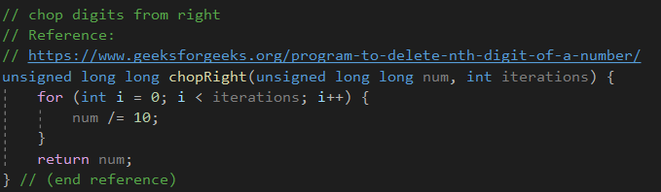
Algorithm
This function will chop digits from the right, leaving us with our left number.

Slide 24
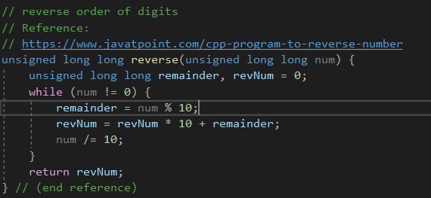
Algorithm
This function will reverse the digits of a number. We will use this for the number on the right. The idea is to reverse the number, chop digits from the end, then reverse the number again.

Slide 25

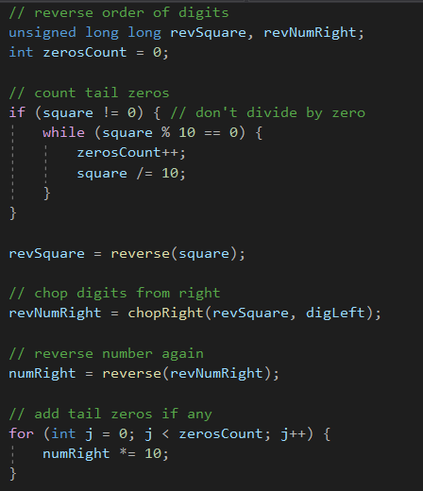
Algorithm
So here is how we get our left number.
Our right number is not so easy. Tailing zeros were a problem when reversing a number. Example:
4950² = 24502500 → 2450 + 2500 = 4950
24502500 reversed is 00520542, then chop 4 digits:
0052, but the program will ignore the leading zeros,
so we need to count them and multiply by 10 for each one.

Slide 26
Algorithm
Now we finally check if the left number and right number add to be the iterator that we squared initially. If it is, print it. If not, try the next number.

Slide 27
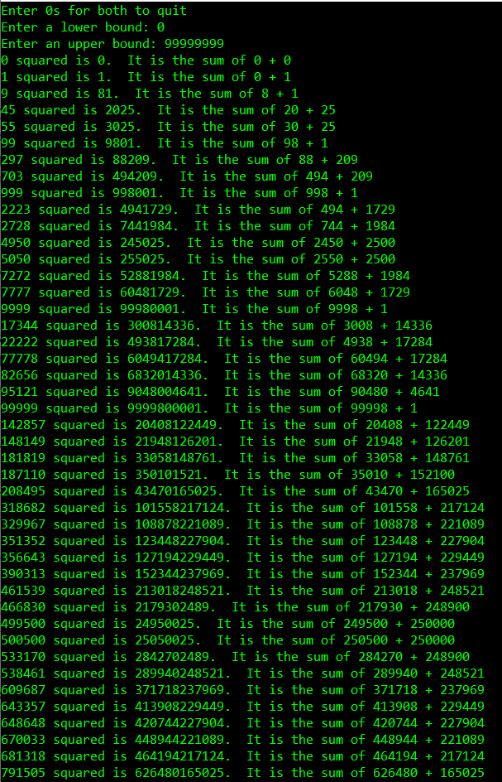
Results
The most extensive list online only went to 99999.
There is error at 187110, squared is 35010152100, but the tail zeros were caught by the addition sentence, and it is a Kaprekar number. It is difficult to tell where the program loses accuracy as my scientific calculator ends up putting the large numbers in scientific notation and rounding off the end.

Slide 28
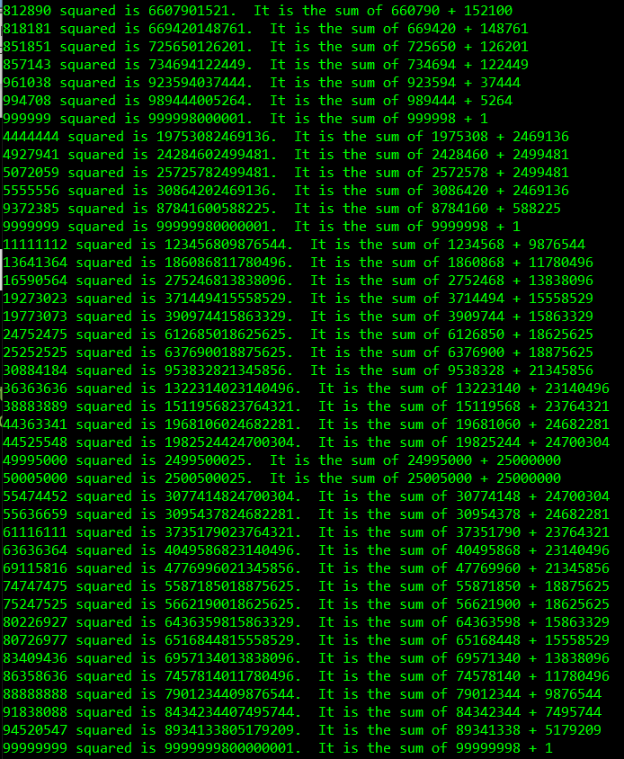
Results
It continued. The program took a lot of time to finish. 99999999 was the number at which I had asked it to stop.

Slide 29
Part III:
Lucky Numbers

Slide 30
Definition
Lucky numbers are those left remaining after starting with a sequence of positive integers, striking out those that are of each index interval of the first integer greater than 1.

Slide 31

Example:
For an interval 1 2 3 4 5 6 7 8 9 10 , the first step is to identify the first integer greater than 1, which is 2.
So every second integer is struck out, leaving us with:
Now the next integer is 3, so we strike out every third integer:
↑ ↑ ↑
X
X
X
X
X
X
X
X
X
X
X

Slide 32
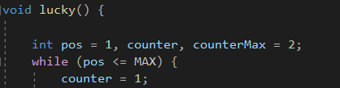
Algorithm
Given an array, we need to strike out places on indexes determined by the values left after each iteration. Using the array a[1000], we start with a while loop.
Here we start with our index position pos, an iterating counter, and a counter maximum value. The while loop will iterate over the full array, resetting the counter to 1 at the beginning of every iteration.

Slide 33

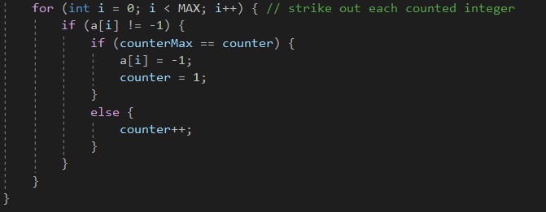
Algorithm
If the value at the current position has not been stricken out, we set counterMax equal to that value.
Still inside the if condition, we iterate over the full sequence, setting the value at each desired index to -1, thus striking it out.

Slide 34
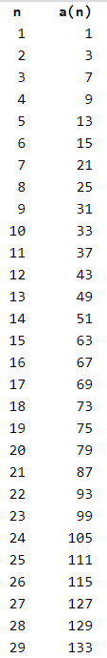
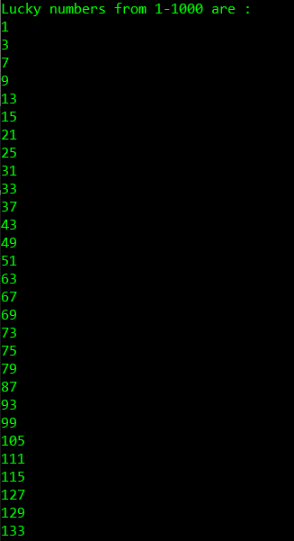
Results
The program prints the desired, correct results

Slide 35
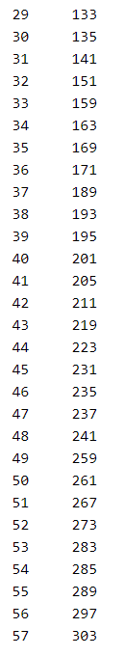
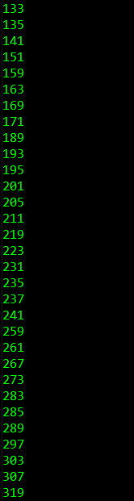
Results
Continued. This is all the included numbers one the OEIS list A000959.

Slide 36
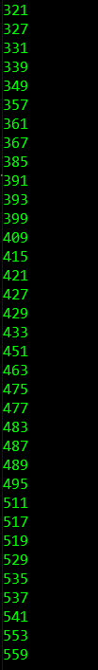

Results
Continued.

Slide 37
References
https://www.britannica.com/science/perfect-number
https://www.geeksforgeeks.org/aliquot-sum/
https://byjus.com/maths/perfect-numbers/
https://mathcs.clarku.edu/~djoyce/java/elements/bookIX/propIX36.html
https://oeis.org/A000396/list
Perfect Numbers

Slide 38
References
https://onlinejudge.org/external/9/974.pdf
https://cs.uwaterloo.ca/journals/JIS/VOL3/iann2a.html
http://mathworld.wolfram.com/KaprekarNumber.html
http://oeis.org/A053816
http://oeis.org/A006886
https://rosettacode.org/wiki/Kaprekar_numbers#Casting_Out_Nines_.28fast.29
Kaprekar Numbers

Slide 39
References
http://mathworld.wolfram.com/LuckyNumber.html
http://oeis.org/A000959/list
Lucky Numbers

